Slide 1
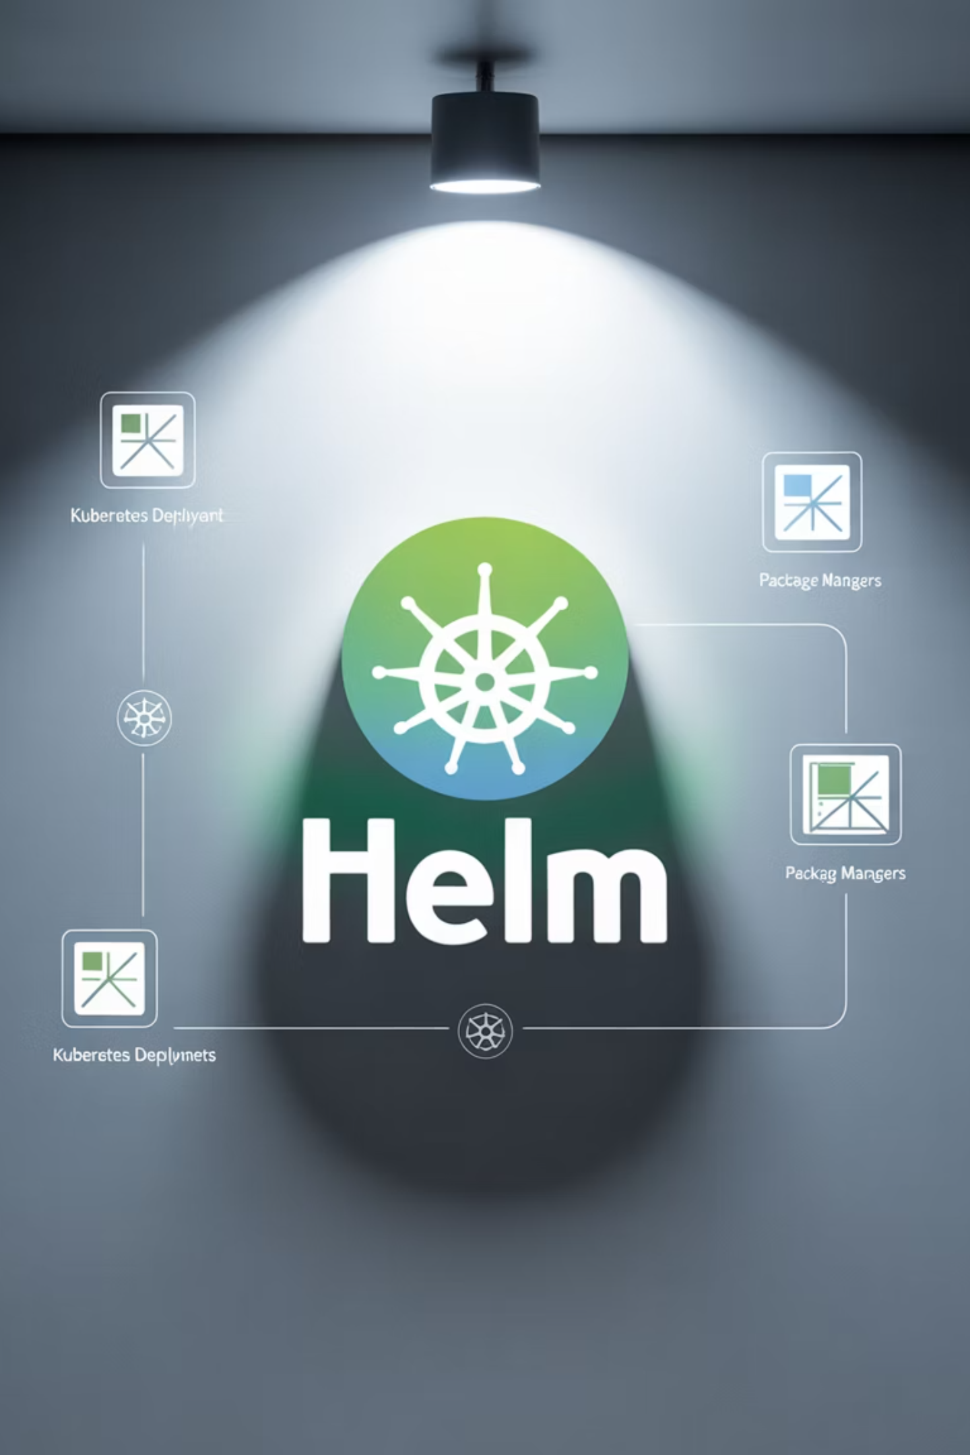
Mastering Helm Charts
A comprehensive guide to Kubernetes package management

Slide 2
Agenda
Introduction to Helm
Helm Architecture
Understanding the Kubernetes package manager
Components and how they work together
Helm Chart Structure
Hands-on with Helm Charts
Anatomy of charts and templates
Practical commands and implementations
Advanced Helm Features
Best Practices & Use Cases
Hooks, dependencies, and conditionals
Real-world applications and recommendations

Slide 3

Why Helm?
Managing Kubernetes applications involves multiple YAML files that can be difficult to track and maintain. Helm solves this by acting as a package manager for Kubernetes.
Key Benefits
Package, share, and reuse applications
Version-controlled deployments
Easy upgrades and rollbacks

Slide 4


Helm vs kubectl
kubectl
Helm
Applies static YAML files directly to the Kubernetes cluster
Applies templates with configurable values
Manual, error-prone process
Dynamic, configurable, repeatable
kubectl apply -f deployment.yaml
kubectl apply -f service.yaml
kubectl apply -f ingress.yaml
helm install myapp ./myapp
Helm simplifies deployment by packaging multiple resources together with configurable parameters.

Slide 5


Demo: Installing from a Repository
Let's see how easy it is to install an application using Helm:
helm repo add bitnami https://charts.bitnami.com/bitnami
helm search repo nginx
helm install my-nginx bitnami/nginx
With just three commands, we've added a repository, searched for a chart, and deployed an application!
Which of the following is NOT a benefit of Helm?
A) Simplifies app deployment
B) Automates chart upgrades and rollbacks
C) Provides built-in monitoring for pods
D) Reuses configuration templates
Answer: C

Slide 6
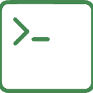



Helm Components
Helm CLI
Charts
The command-line interface that interacts with Kubernetes API and manages charts and releases
Packages of pre-configured Kubernetes resources, like a bundle of YAML files
Repository
Release
Storage location for charts, similar to Docker Hub for container images
An instance of a chart running in a Kubernetes cluster with specific configuration

Slide 7
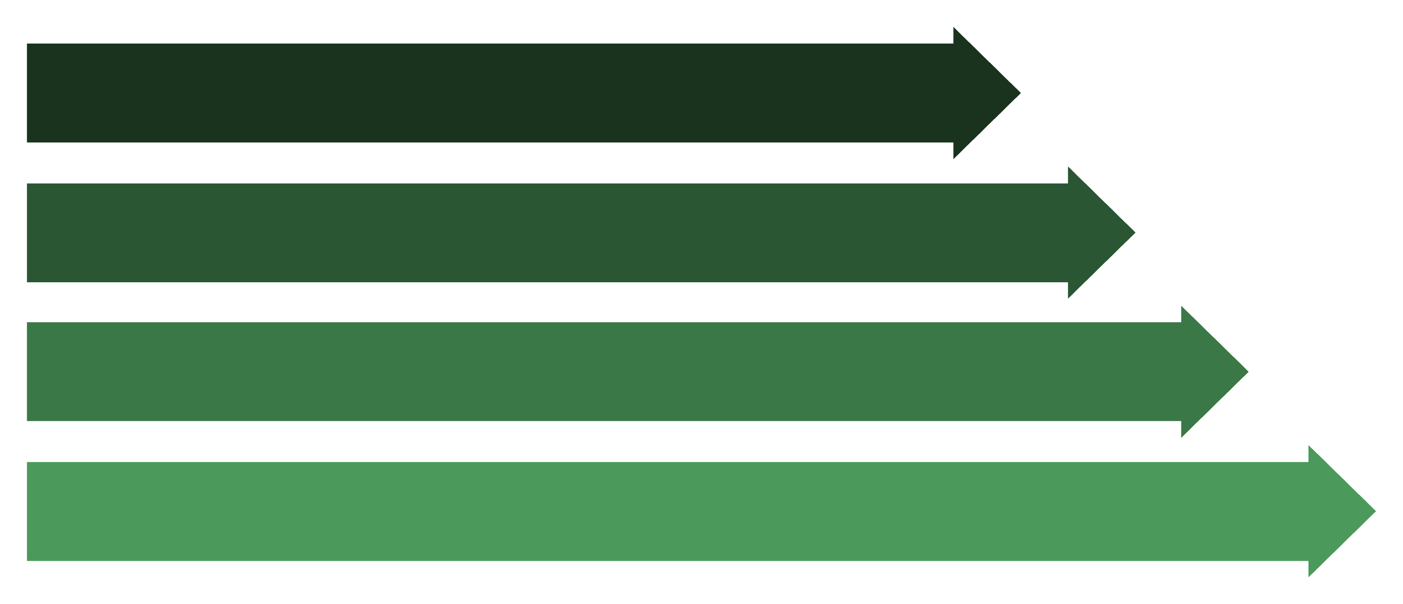
Helm Architecture
User CLI
Helm Repo
Helm Engine
Kubernetes API
Helm simplifies the deployment process by handling the complexity of managing multiple Kubernetes resources through a single interface.

Slide 8




Release Lifecycle
helm install
helm upgrade
Creates a new release from a chart
Updates an existing release with new values
helm rollback
helm uninstall
Restores a previous release version
Removes a release from the cluster
Helm tracks each deployment as a release, making it easy to manage the entire lifecycle of your applications.

Slide 9
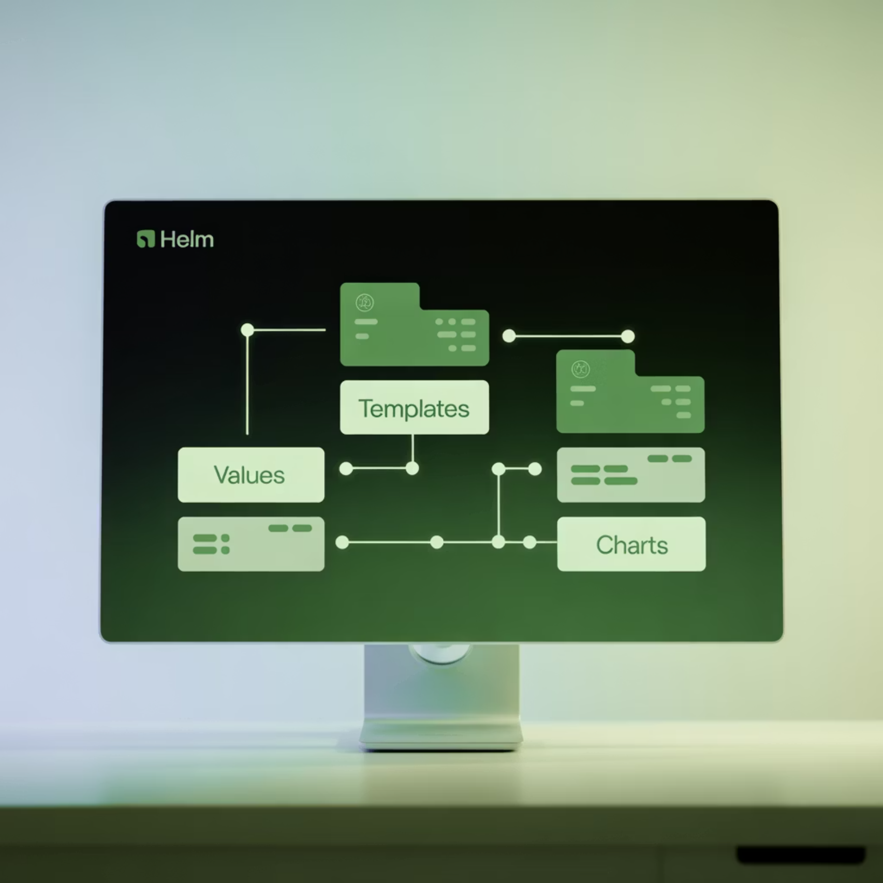
Helm Chart Structure
mychart/ Chart.yaml # Chart metadata
values.yaml # Default values
templates/ # K8s manifest templates
charts/ # Dependencies
NOTES.txt # Post-install notes
A Helm chart is organized in a specific directory structure that contains all the necessary files to deploy an application.
Each component serves a specific purpose in the chart's functionality, from defining metadata to providing templates for Kubernetes resources.

Slide 10
Chart.yaml (Metadata)
The Chart.yaml file contains essential metadata about your Helm chart:
apiVersion: v2
name: myapp
description: A simple Helm chart for Kubernetes
version: 0.1.0
appVersion: "1.0"
apiVersion
name
Specifies the Helm API version (v2 is current)
The name of the chart
version
appVersion
The chart version (follows SemVer)
The version of the application being deployed

Slide 11

values.yaml (Defaults)
The values.yaml file defines default configuration values that can be overridden during installation:
replicaCount: 2
image: repository: nginx
tag: "1.25"service:
type: ClusterIP
port: 80
These values can be referenced in templates using the {{ .Values }} object, making charts highly configurable without modifying the templates themselves.

Slide 12

templates/deployment.yaml
Templates use Go templating syntax to insert values dynamically:
You need to deploy an app with 5 replicas and NodePort service. Which file should you edit?
A) Chart.yaml
B) values.yaml
C) deployment.yaml directly
D) NOTES.txt
apiVersion: apps/v1
kind: Deployment
metadata:
name: {{ .Release.Name }}-{{ .Chart.Name }}
spec:
replicas: {{ .Values.replicaCount }}
selector:
matchLabels:
app: {{ .Chart.Name }}
template:
metadata:
labels:
app: {{ .Chart.Name }}
spec:
containers:
- name: {{ .Chart.Name }}
image: "{{ .Values.image.repository }}:{{ .Values.image.tag }}"
ports:
- containerPort: {{ .Values.service.port }}

Slide 13

Basic Helm Commands
01
02
03
Create a new chart
Install a chart
List releases
helm create myapp
helm install myapp ./myapp
helm list
Generates a new chart with default structure and templates
Deploys the chart to your Kubernetes cluster
Shows all deployed releases in the current namespace

Slide 14
Overriding Values
Using --set flag
Using custom values file
helm install myapp ./myapp \ --set replicaCount=3
helm install myapp ./myapp \ -f custom-values.yaml
Overrides individual values directly from the command line
Overrides values using a separate YAML file with custom configurations
These methods allow you to customize deployments without modifying the original chart files, making it easy to maintain different configurations for different environments.

Slide 15
Upgrade and Rollback
Upgrade a release
1
helm upgrade myapp ./myapp --set replicaCount=4
2
View release history
Updates an existing release with new values or chart version
helm history myapp
Rollback to previous version
3
Shows all revisions of a release for tracking changes
helm rollback myapp 1
Reverts to a specific revision number (in this case, revision 1)
Helm's version control capabilities make it easy to manage application lifecycle and recover from problematic deployments.

Slide 16

Debugging Helm Charts
Preview rendered templates
Uninstall a release
helm uninstall myapp
helm template ./myapp
Removes a release from the cluster
Shows the YAML that would be applied without actually installing
Practice Lab Task
Inspect a release
Create a chart named demoapp
Deploy with 2 replicas
helm get all myapp
Upgrade to 4 replicas
Rollback to previous version
Displays all information about a release

Slide 17
Helm Hooks
Hooks allow you to intervene at specific points in a release's lifecycle:
apiVersion: batch/v1kind: Jobmetadata: name: "{{ .Release.Name }}-db-init" annotations: "helm.sh/hook": pre-installspec: template: spec: containers: - name: db-init image: postgres:15
Common Hook Types
Use Cases
pre-install: Run before the release is installed
Database migrations
post-install: Run after the release is installed
Secret setup
pre-delete: Run before a release is deleted
Resource cleanup

Slide 18
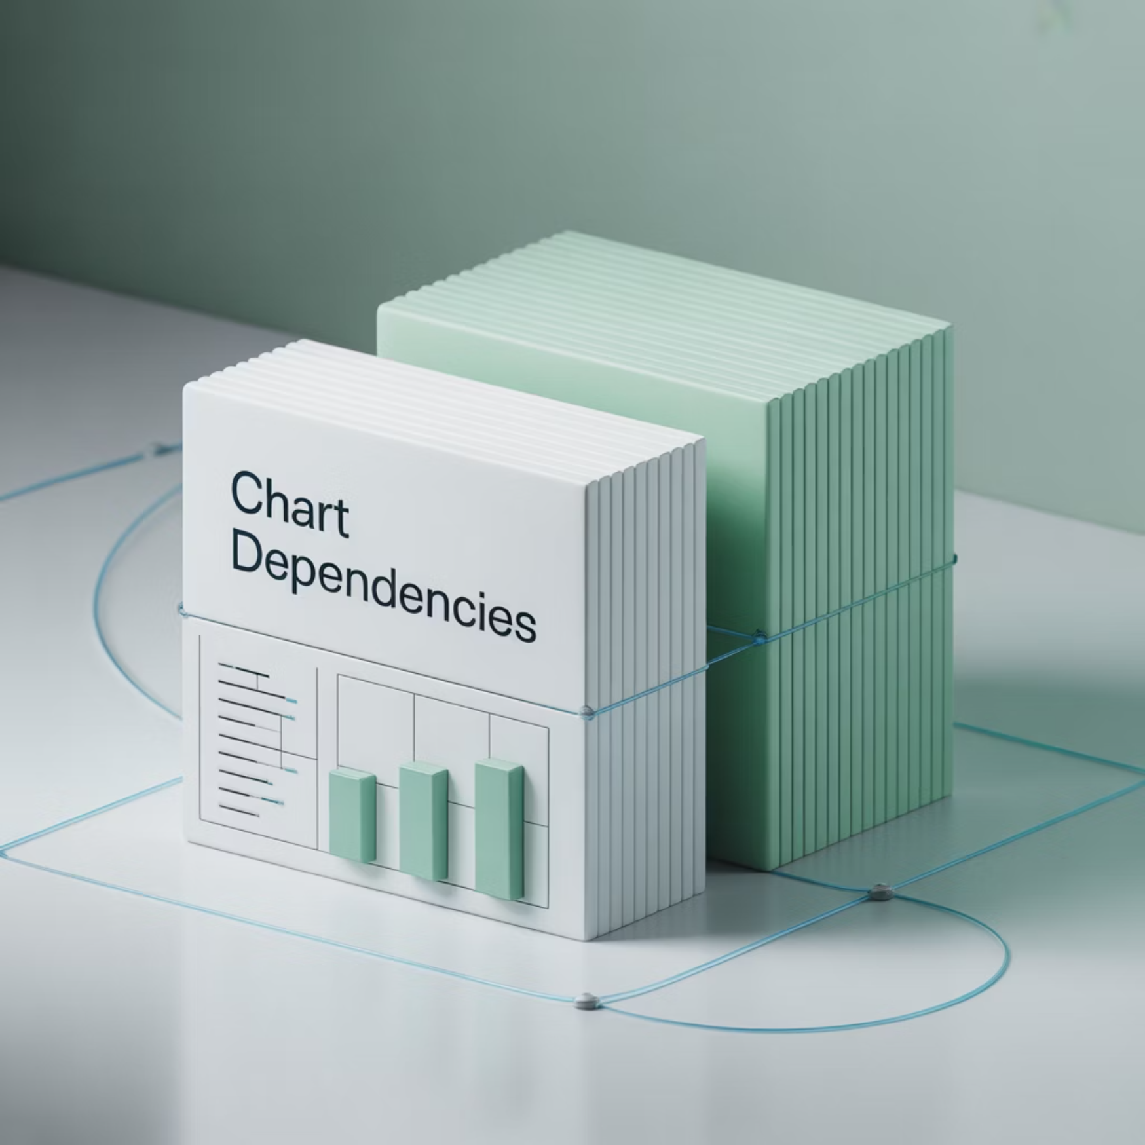
Chart Dependencies
Charts can depend on other charts, creating a modular architecture:
Managing Dependencies
dependencies:- name: redis version: "16.13.2" repository: "https://charts.bitnami.com/bitnami"
# Update dependencieshelm dependency update ./myapp# Build dependencieshelm dependency build ./myapp
Define dependencies in Chart.yaml and store sub-charts inside the charts/ directory.

Slide 19

Conditionals and Loops
Conditionals
Loops
{{- if .Values.service.enabled }}apiVersion: v1kind: Servicemetadata: name: {{ .Release.Name }}-service{{- end }}
{{- range $name, $port := .Values.service.ports }}- name: {{ $name }} port: {{ $port }}{{- end }}
Iterate over collections to generate repeated blocks
Only include resources when certain conditions are met
Which Helm feature is best for running a database initialization job before installing a chart?
A) Conditionals
B) Loops
C) Hooks
D) Dependencies
Answer: C

Slide 20

Best Practices & Real-world Use Cases
Best Practices
Real-world Use Cases
Keep values.yaml clean and minimal
Deploy NGINX Ingress Controller
Use CI/CD pipelines for Helm deployments
Deploy Prometheus + Grafana stack
Use helm lint for validation
Deploy custom microservices
Version lock dependencies
Key Takeaways
Helm simplifies Kubernetes app management
Charts = reusable, parameterized packages
Releases = tracked versions of charts
Advanced features → hooks, dependencies, conditionals

